Slide 1
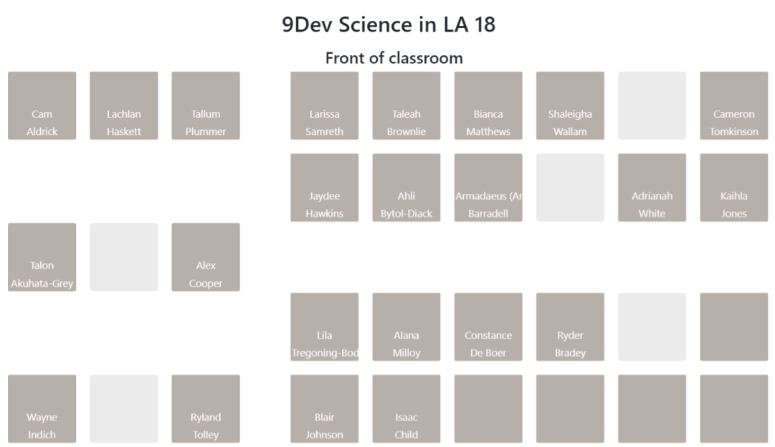
Do Now
Collect the following before sitting in your assigned seat:
Your folder + book.
A pen or pencil.
Coloured Pencils (1 box between 2)

Slide 2


Isotopes
We will understand how isotopes form
Notes:
Insert cover image and use transparency settings to fade image.

Slide 3
We will understand how isotopes form
TRACK WITH ME
READ WITH ME
^{Define the term isotope}
Explain how to write the atomic symbol of an isotope
Calculate the number of protons, neutrons, and electrons in an isotope

Slide 4
We will understand how isotopes form
How do we know dinosaur bones are millions of years old?
How do we know that the Australia’s First Peoples arrived in Northern Australia 65,000 years ago?
How do we know that the age of the Earth is approximately 4.54 billion years old?
Isotopes have many uses across agriculture, the food industry, pest control, archeology, and medicine.
Isotopes are used to conduct Radiometric Dating This measures the age of materials, based upon comparing the decay of isotopes.

Slide 5
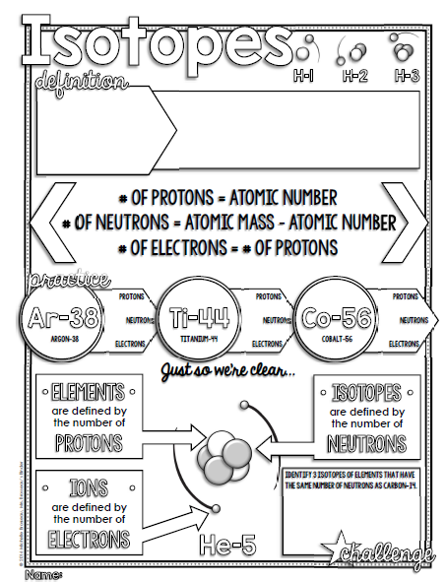
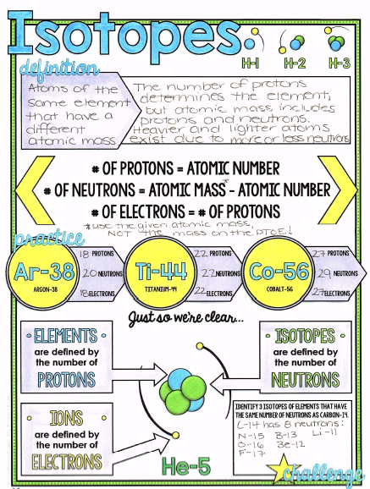
We will understand how isotopes form

Slide 6
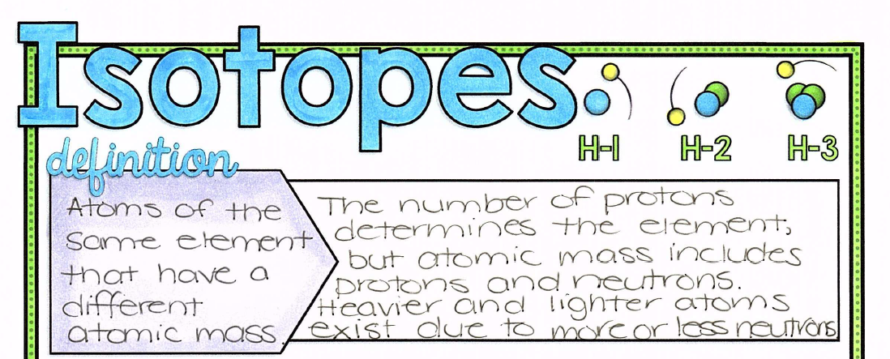
We will understand how isotopes form

Slide 7
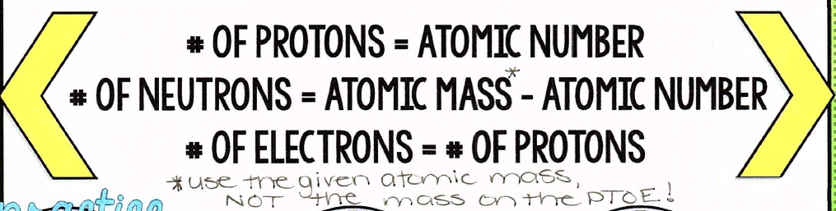
We will understand how isotopes form

Slide 8
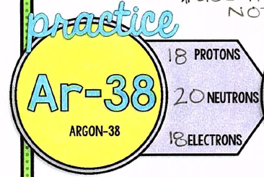
We will understand how isotopes form

Slide 9
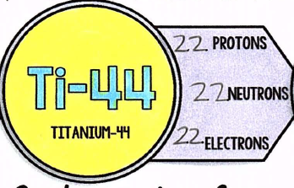
We will understand how isotopes form

Slide 10
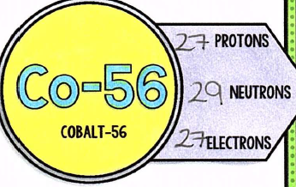
We will understand how isotopes form

Slide 11
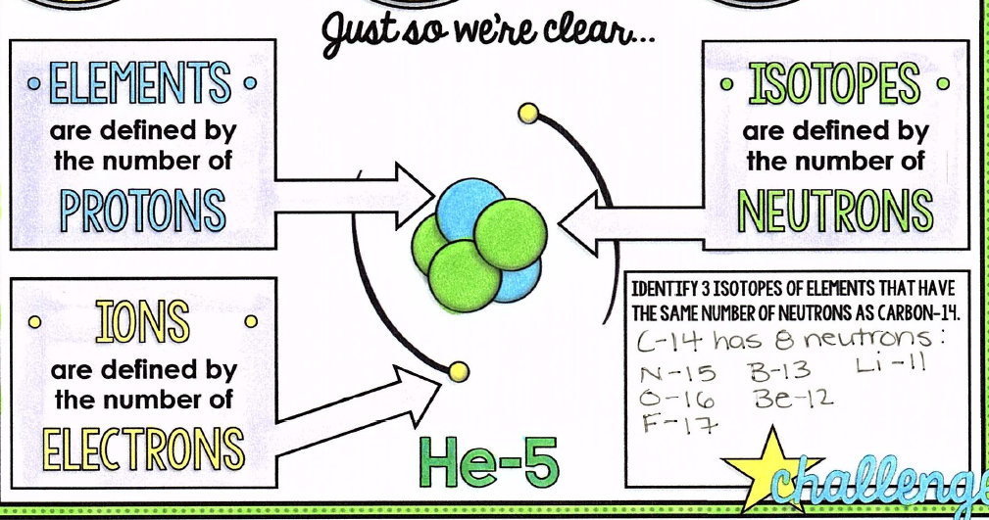
We will understand how isotopes form

Slide 12
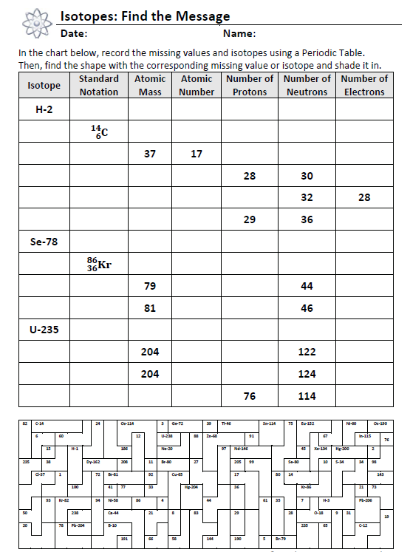
We will understand how isotopes form
First 4 rows in class – the remainder is for Homework!

Slide 13
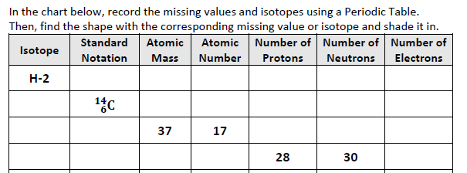

Slide 14
We will understand how isotopes form
TRACK WITH ME
READ WITH ME
^{Define the term isotope}
Explain how to write the atomic symbol of an isotope
Calculate the number of protons, neutrons, and electrons in an isotope

